Slide 1
EGS Collab: Elastic Property Measurements
Ben Jahnke, Hiroki Sone, Herb Wang
University of Wisconsin-Madison

Slide 2
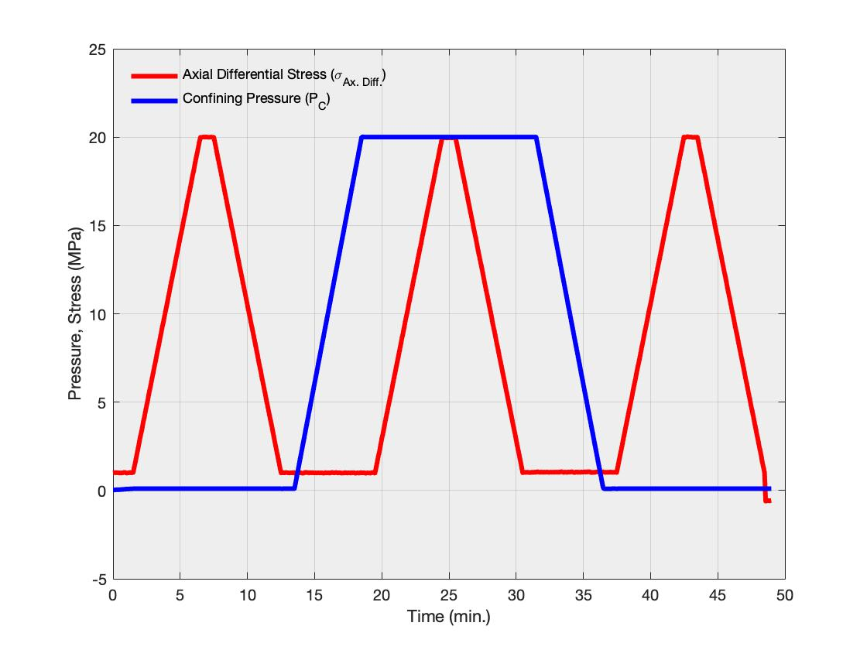
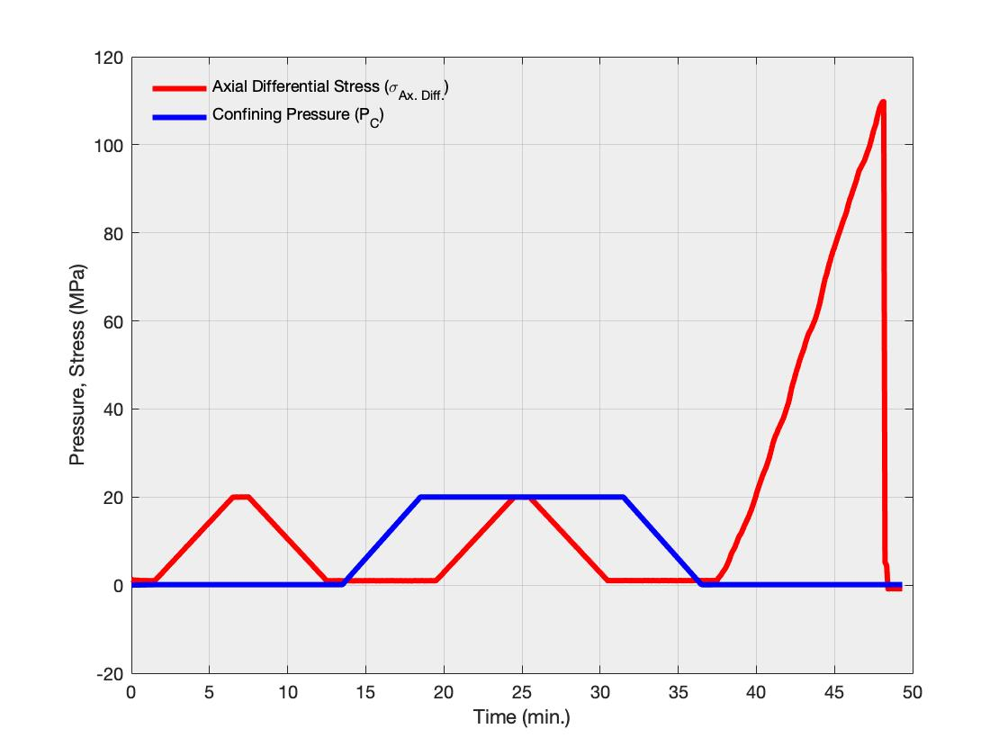
Method
2 experimental protocols
Uniaxial loading/unloading ⇒ Triaxial loading/unloading ⇒ Uniaxial loading/unloading
Uniaxial loading/unloading ⇒ Triaxial loading/unloading ⇒ Uniaxial loading until failure

Slide 3
Materials
8 total tests
4 amphibolites tested
2 brought to failure
4 rhyolites tested
2 brought to failure
Sample Name | Rock Type | Rock Core | Depth Into Borehole
9-3 1 | Amphibolite | TH4100 | 6.9’ - 12.05’
9-3 2 | Amphibolite | TH4100 | 6.9’ - 12.05’
5P1 | Amphibolite | TV4100 | 90.25’ - 95.3’
5P2 | Amphibolite | TV4100 | 90.25’ - 95.3’
9-29 1 | Rhyolite | TV4100 | 120.25’ - 125.3’
9-29 2 | Rhyolite | TV4100 | 120.25’ - 125.3’
7P1 | Rhyolite | TV4100 | 120.25’ - 125.3’
7P2 | Rhyolite | TV4100 | 120.25’ - 125.3’

Slide 4
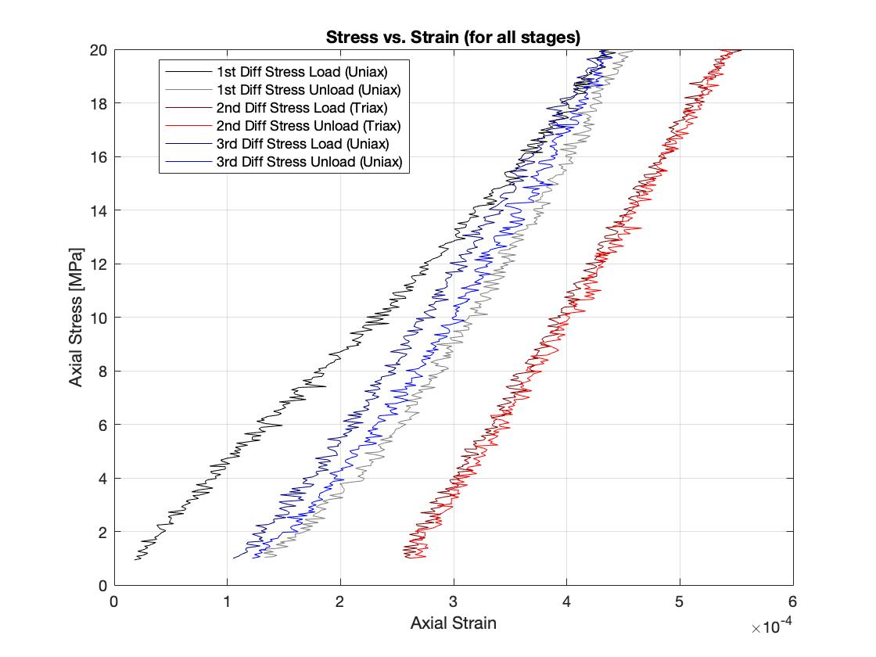
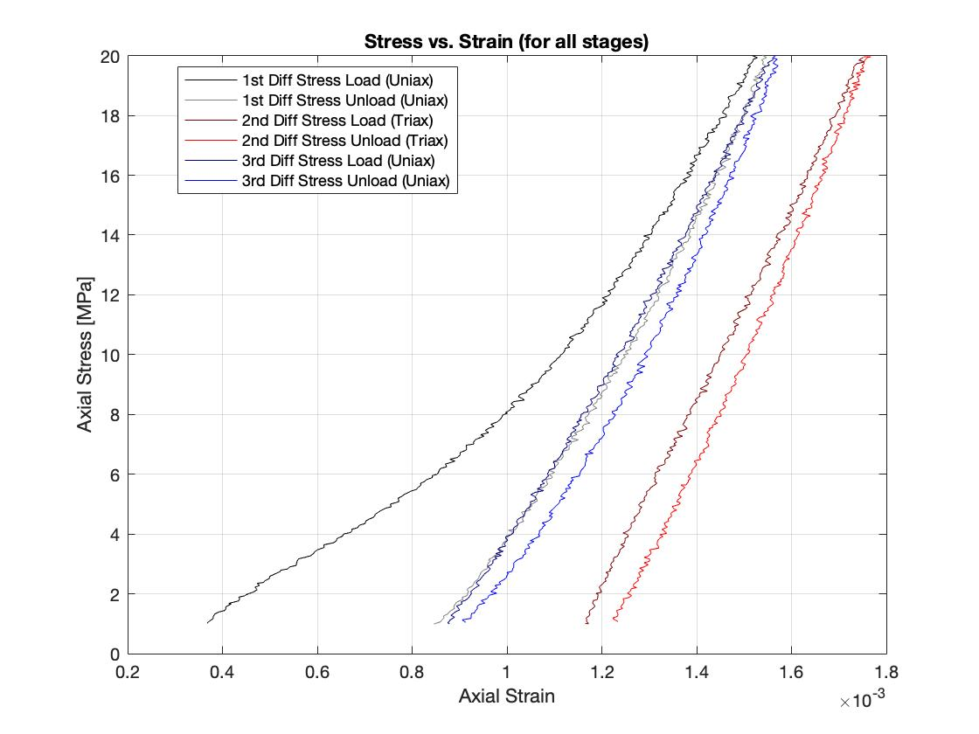
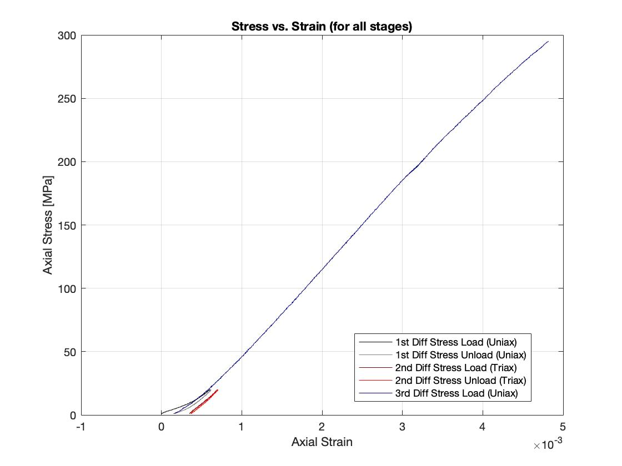
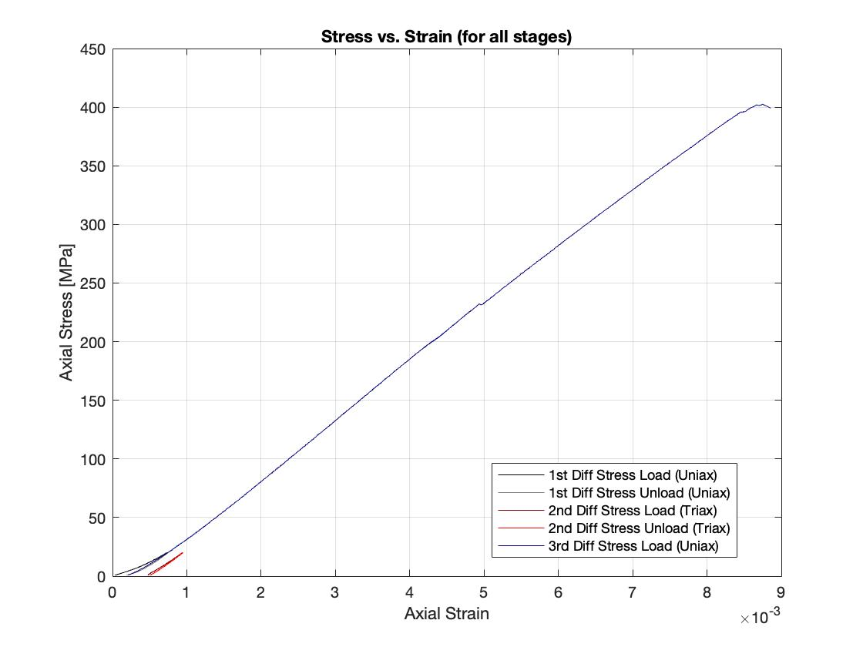
Raw Data - Stress-Strain Curves
Amphibolite
(Unbroken)
Rhyolite
(Unbroken)
Amphibolite
(Broken)
Rhyolite
(Broken)

Slide 5
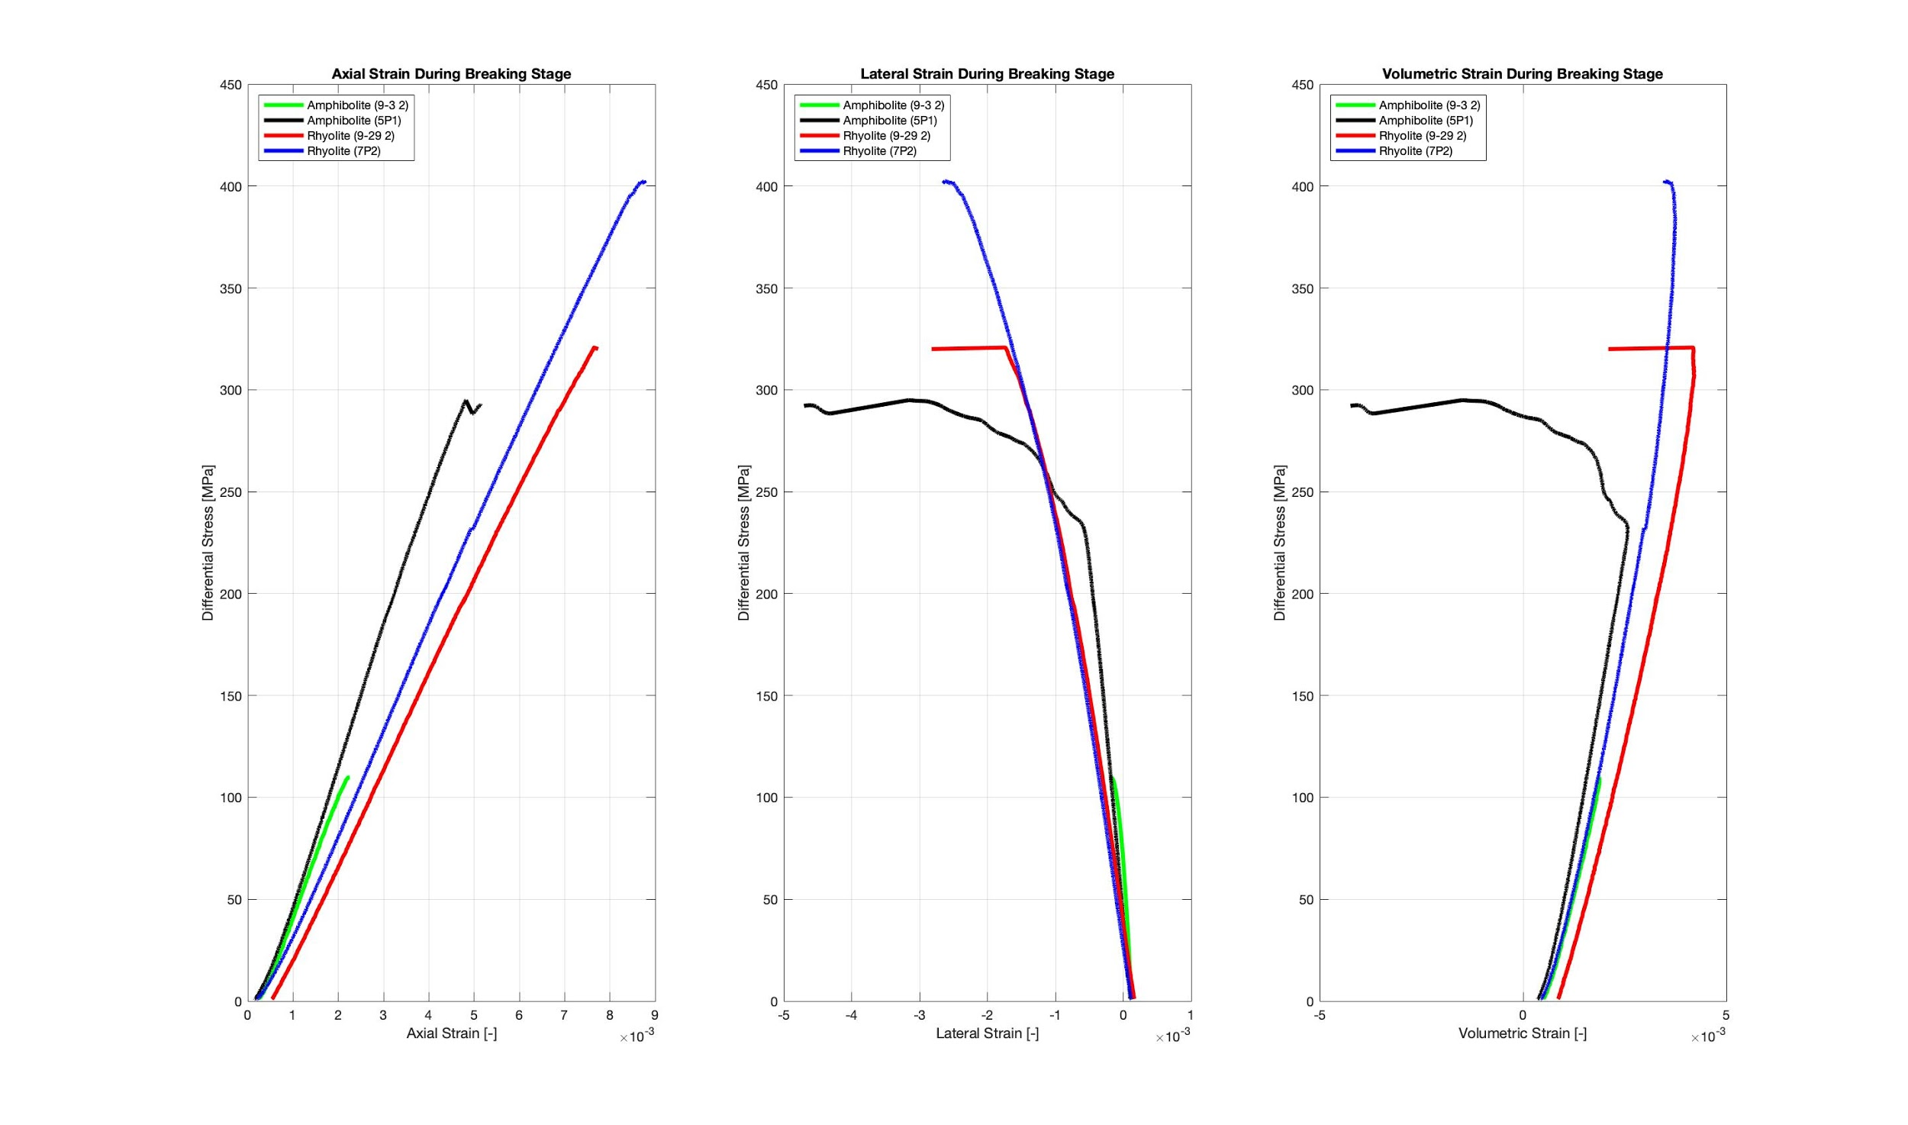
Raw Data - Stress-Strain Curves (Axial, Lateral, Vol)

Slide 6
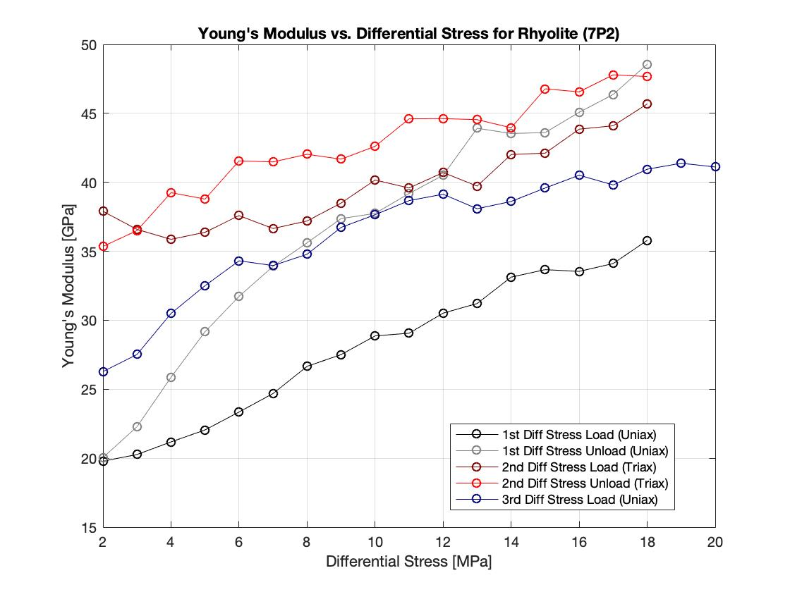
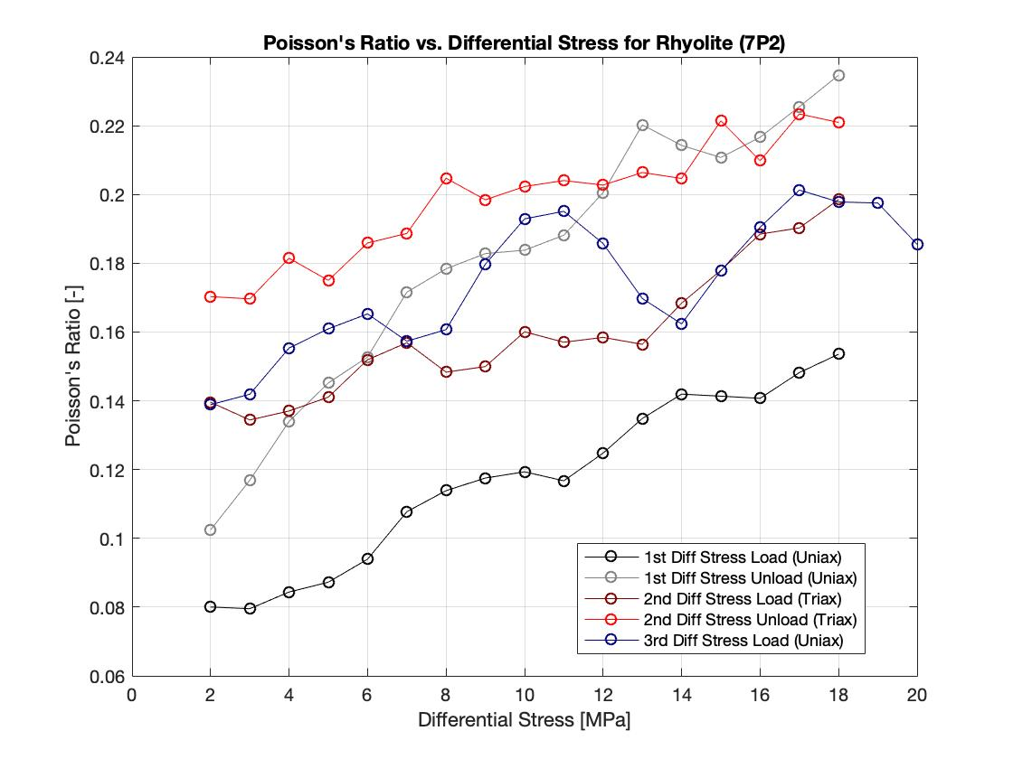
Static Elastic Property Measurements
Calculated using the data from from the 1st and 2nd differential stress unloads
Averaged E and v from 1st and 2nd differential stress unload when differential stress = 18 MPa
G and M calculated from E and v

Slide 7
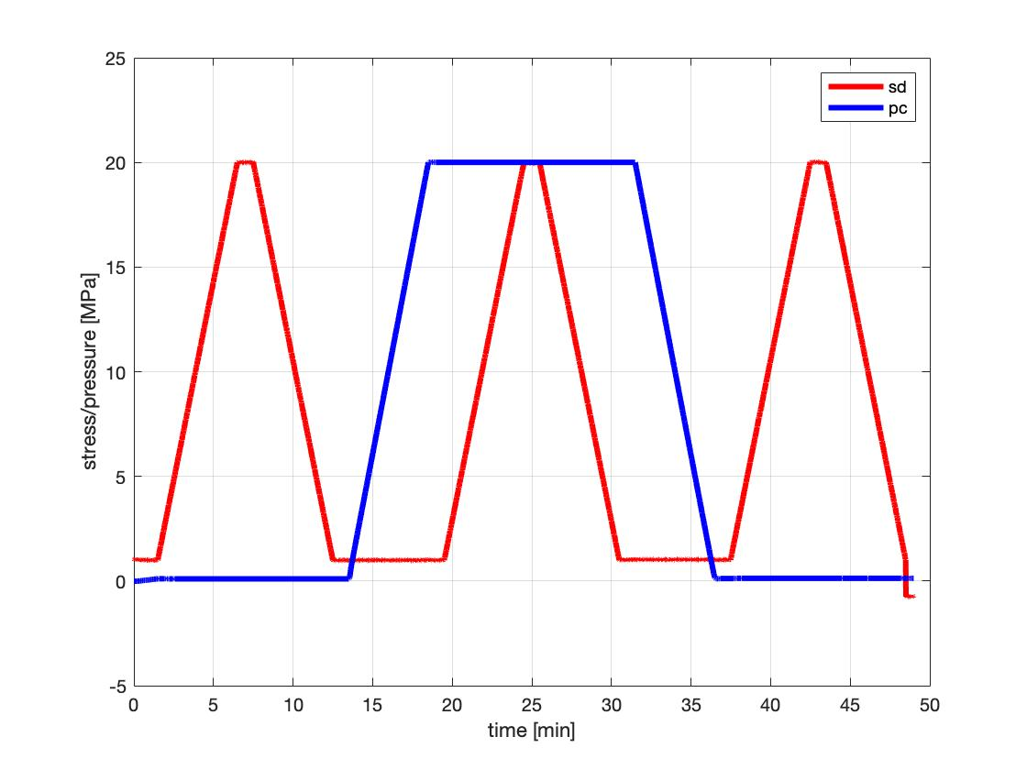
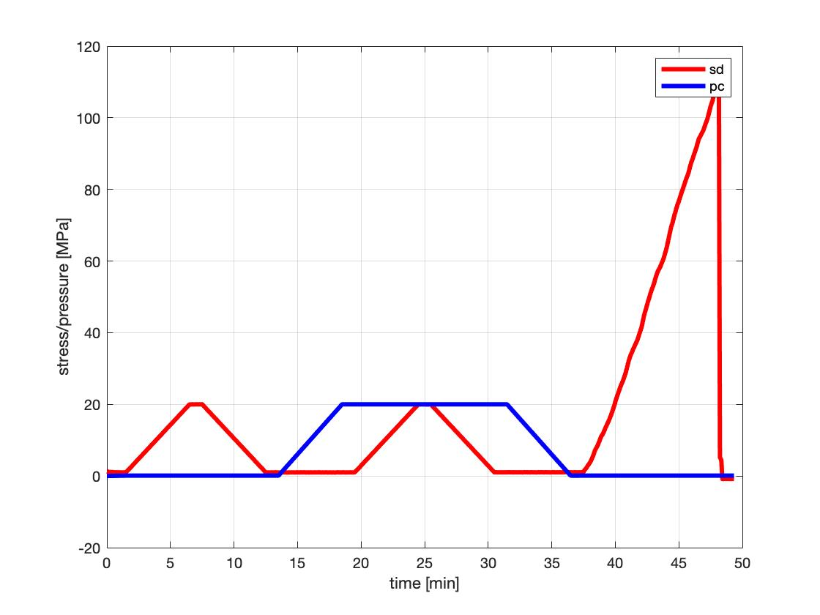
Dynamic Elastic Property Measurements
Calculated using the ultrasonics measurements taken when differential stress = 20 MPa (indicated by the purple arrows)
Averaged M and G from the 3 ultrasonics measurements taken when differential stress = 20 MPa
E and v calculated from M and G

Slide 8
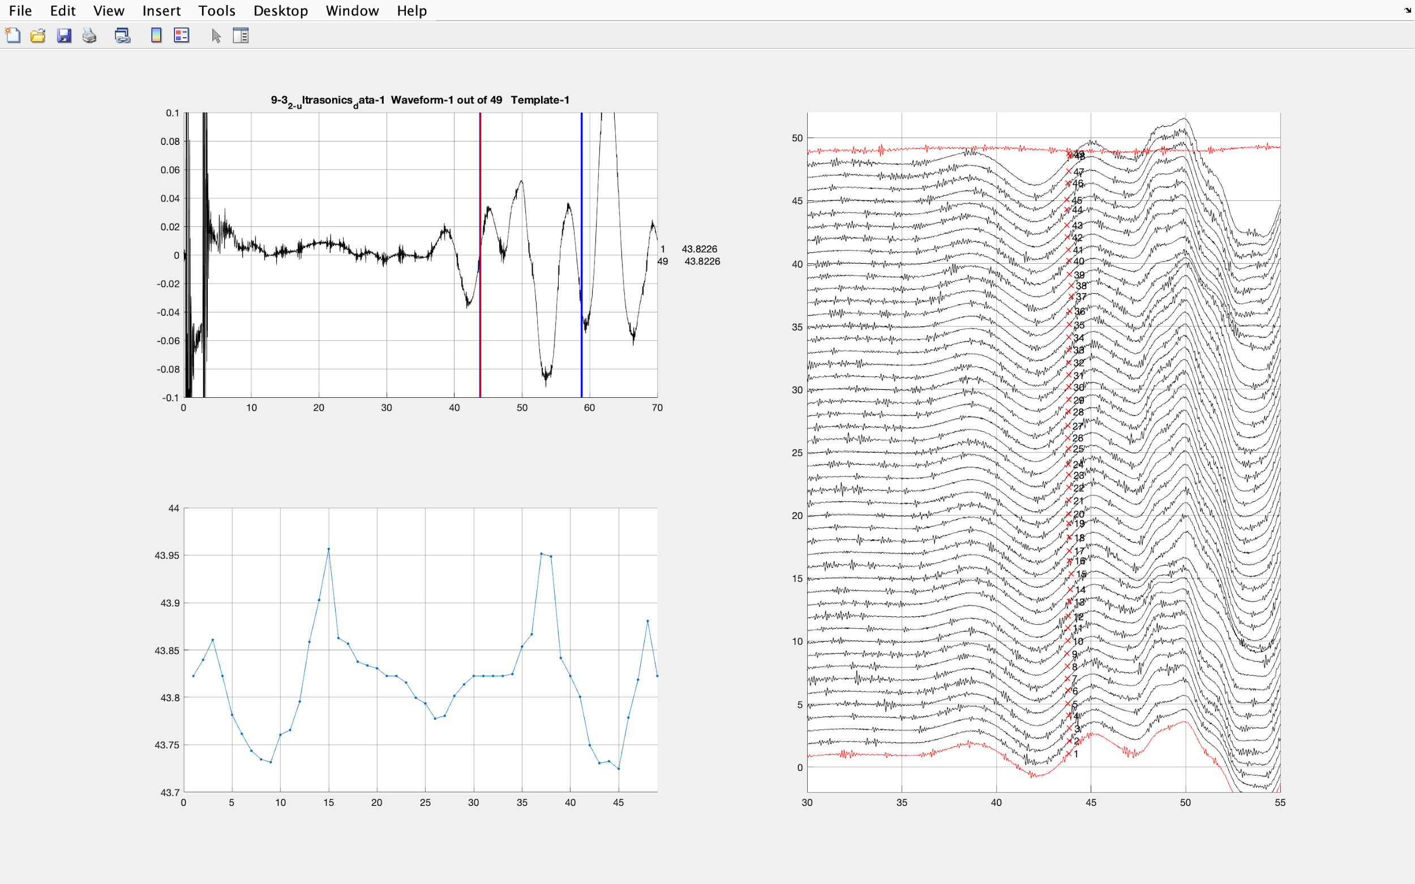
Shear Velocity Uncertainties
First two amphibolite ultrasonic datasets (200 kHz transducers used) difficult to know where first arrivals are for S1-waves and S2-waves
Selected points in the waveform that produced arrival times that seemed reasonable
Produced S-wave velocities that are lower than wireline velocities and later test velocities
No dynamic G found for first two amphibolites therefore no dynamic E or v
1 MHz transducers used in later tests

Slide 9
Static and Dynamic Elastic Property Measurements
(when differential stress = 20 MPa)
 | Static |  |  |  | Dynamic
 | E [GPa] | v [-] | G [GPa] | M [GPa] | E [GPa] | v [-] | G [GPa] | M [GPa
Amphibolite (9-3 1) | 68.4 | 0.23 | 27.9 | 78.7 | - | - | - | 103.1
Amphibolite (9-3 2) | 70.6 | 0.11 | 31.8 | 72.5 | - | - | - | 110.9
Amphibolite (5P1) | 61.3 | 0.18 | 26.0 | 66.5 | 113.2 | 0.23 | 45.9 | 132.1
Amphibolite (5P2) | 68.3 | 0.18 | 28.9 | 74.3 | 113.3 | 0.23 | 45.9 | 132.2
Rhyolite (9-29 1) | 45.8 | 0.21 | 19.0 | 51.3 | 70.1 | 0.20 | 29.3 | 77.4
Rhyolite (9-29 2) | 51.1 | 0.23 | 20.7 | 59.5 | 70.9 | 0.21 | 29.3 | 79.8
Rhyolite (7P1) | 39.4 | 0.15 | 17.1 | 41.7 | 62.9 | 0.27 | 24.8 | 78.4
Rhyolite (7P2) | 48.1 | 0.23 | 19.6 | 55.6 | 65.1 | 0.26 | 25.7 | 80.3

Slide 10
Dynamic Elastic Properties from Log Velocities
Assumed densities:
Amphibolite = 3050 kg/m³
Rhyolite = 2500 kg/m³
Log velocities calculated at same depth of samples tested
Depths into TV4100
Amphibolite = 27.5 m - 29.0 m
Rhyolite = 36.7 m - 38.2 m
G = ρV_{S}²
M = ρV_{P}²
 | Amphibolite | Rhyolite
V_{P} [m/s] | 5660 - 5882 | 5172 - 5263
V_{S} [m/s] | 3529 - 3703 | 3125 - 3158
E [GPa] | 89.8 - 98.0 | 59.2 - 60.8
v [-] | 0.17 - 0.18 | 0.21 - 0.22
G [GPa] | 38.0 - 41.8 | 24.4 - 24.9
M [GPa] | 97.7 - 105.5 | 66.9 - 69.2

Slide 11
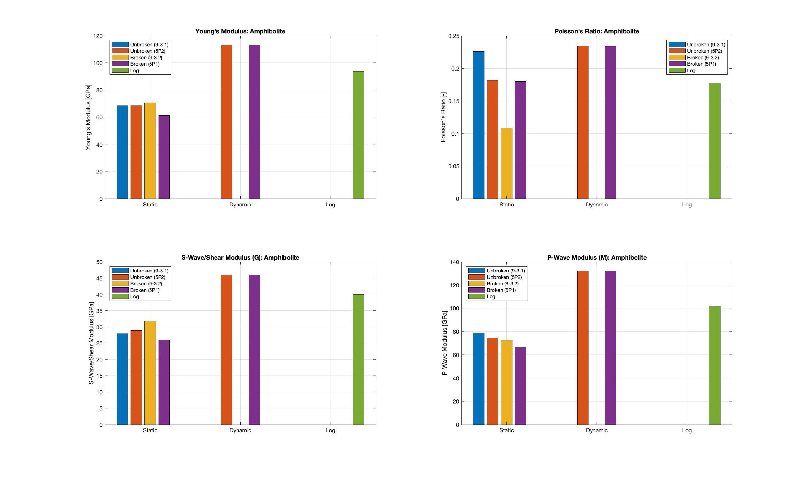
Elastic Properties: Amphibolite

Slide 12
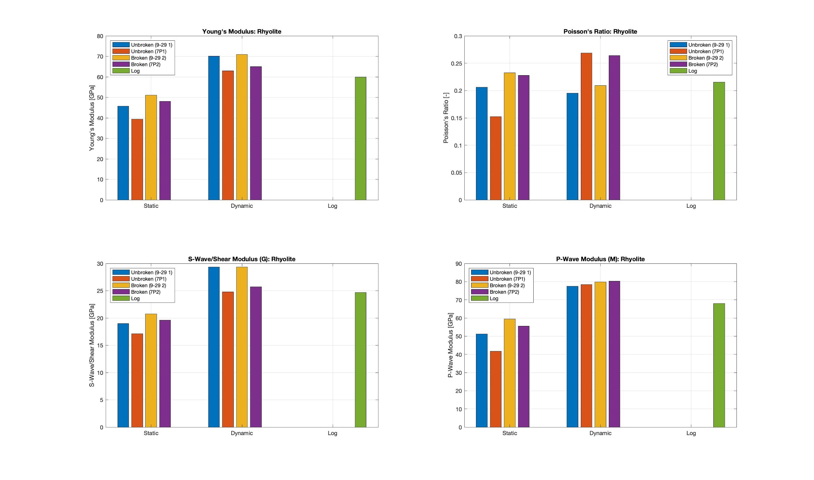
Elastic Properties: Rhyolite

